Slide 1
Resource Reservation
Resource reservation refers to the process of allocating and reserving network resources in advance to ensure that they are available when needed.
This is particularly needed that require guaranteed service.
Bandwidth reservation-Guaranteeing a minimum amount of bandwidth for specific applications or users to ensure they have sufficient network capacity.
Buffer reservation: Reserving buffer space in network devices to handle bursty traffic or prioritize critical traffic.
Queue reservation : Allocating a dedicated queue priority for high priority traffic to ensure that it gets sufficient network resources.
CPU cycles: It takes CPU time to process a packet. Router can process only a certain number of packets per second.
T=1 / µ * 1 / 1- Р where p=λ / µ , ; λ mean arrival rate packets / sec, µ mean processing packets / sec.
Resource reservation in networks achieved through various techniques:
500

Slide 2
Resource Reservation
Reservation Protocols: Using protocols such as RSVP (Resource Reservation Protocol) to establish and maintain reservations across network paths.
MPLS: MPLS stands for Multiprotocol Label Switching. It is a protocol-agnostic routing technique designed to speed up and shape traffic flows across complex networks, including both enterprise and service provider networks.
Quality of Service : A set of technologies that enable network administrators to prioritize and reserve resources for critical applications.
Benefits of Resource reservation :
Guaranteed performance
Improve reliability
Enhance user experience
500

Slide 3
Admission Control
Admission control in networking refers to the process of determining whether to accept or reject requests for network resources based on specific criteria, typically to ensure that the network can continue to operate within defined performance parameters and service level agreements (SLAs).
Purpose of Admission Control:
Resource Management: Ensures that network resources such as bandwidth, CPU cycles, memory, etc., are allocated efficiently and fairly among users or applications.
Quality of Service (QoS) Assurance: Guarantees that admitted traffic meets predefined QoS requirements, such as latency, jitter, and packet loss, to maintain a consistent level of service for critical applications.
Network Stability: Prevents overload situations that could lead to network congestion, degradation in performance, or even network failures.
500

Slide 4
Admission Control
Key concepts and Components :
Admission Policies: These are rules and criteria used to decide whether to accept or reject a request for network resources. Policies can be based on factors such as bandwidth availability, priority levels, SLAs, and network congestion levels.
Admission Control Points: These are network elements or devices where admission decisions are made. This could include routers, switches, gateways, or dedicated admission control servers in more complex environments.
Reservation Protocols: Mechanisms such as RSVP (Resource Reservation Protocol) are sometimes used in conjunction with admission control to reserve network resources in advance for specific traffic flows.
Monitoring and Feedback: Continuous monitoring of network conditions and feedback mechanisms help adjust admission decisions dynamically based on real-time network performance and changes in traffic patterns.
500

Slide 5
Admission Control
Implementation and Techniques:
Static Thresholds: Simplest form where fixed limits are set for different types of traffic or users.
Dynamic Thresholds: Adjust admission decisions based on real-time network conditions, such as current traffic load or available resources.
Traffic Policing and Shaping: Techniques that control the rate of traffic entering the network, ensuring that it conforms to agreed-upon traffic profiles.
QoS Mechanisms: Utilize QoS parameters like DiffServ (Differentiated Services) or IntServ (Integrated Services) to classify and prioritize traffic, influencing admission decisions accordingly.
500

Slide 6
Admission Control
Benefits of Admission Control:
Predictable Performance: Ensures that critical applications receive the necessary resources and QoS guarantees.
Efficient Resource Utilization: Prevents resource wastage by only admitting traffic that can be adequately handled without degrading performance.
Network Stability: Helps in maintaining overall network stability and reliability by avoiding overload situations.
SLA Compliance: Ensures that service providers meet their contractual obligations regarding service quality and performance.
Parameters : Token Bucket rate (bytes/sec ) Token Bucket size, Peak data rate (Bytes/ sec), Minimum packet size, Maximum Packet Size.
500

Slide 7
Packet Scheduling
Packet scheduling is a fundamental mechanism in computer networking and telecommunications that determines the order and timing of packet transmission over a network link.
It plays a critical role in optimizing network performance, ensuring fairness among users, and meeting Quality of Service (QoS) requirements.
Purpose of Packet Scheduling:
Resource Allocation: Efficiently allocates network resources (such as bandwidth) among competing traffic flows or users based on defined policies and priorities.
QoS Management: Ensures that packets belonging to different traffic classes (e.g., voice, video, data) receive appropriate levels of service in terms of delay, jitter, and throughput.
Fairness: Distributes network resources fairly among users or applications to prevent any single flow from monopolizing the available bandwidth.
Congestion Management: Helps in managing and mitigating network congestion by prioritizing and controlling the transmission of packets.
500

Slide 8
Packet Scheduling
Key Concepts and Techniques:
Scheduling Algorithms: Various scheduling algorithms are used depending on the specific goals and characteristics of the network.
First Come, First Served (FCFS): Processes packets in the order they arrive.
Round Robin (RR): Alternates between different flows, serving each flow for a fixed amount of time.
Weighted Fair Queuing (WFQ): Assigns weights to different flows and allocates bandwidth proportionally based on these weights.
Priority Queuing (PQ): Prioritizes packets based on predefined priorities, where high-priority packets are served before lower-priority packets.
Deficit Round Robin (DRR): Enhances Round Robin by allowing flows to use the remaining deficit of another flow when it does not use its allocated time slice fully.
Hierarchical Fair Service Curve (HFSC): Provides hierarchical shaping and scheduling, allowing fine-grained control over bandwidth allocation and QoS guarantees.
500

Slide 9
Packet Scheduling
Queue Management: In conjunction with packet scheduling, queue management techniques (e.g., Random Early Detection - RED, Class-Based Queuing - CBQ) are used to control and manage the length of queues and buffer resources.
Policy-Based Scheduling: Policies define rules based on which packets are scheduled, such as based on traffic type (voice, video, best effort data), user priority, or SLA requirements.
Implementation: Packet scheduling algorithms are implemented in network devices such as routers and switches, where they operate at the data link layer (Layer 2) or network layer (Layer 3) depending on the specific requirements and capabilities of the device.
Benefits of Packet Scheduling:
Improved QoS: Ensures that critical applications receive the necessary network resources and perform within acceptable performance parameters.
Fairness: Prevents any single flow or user from dominating network resources, promoting fair access to bandwidth for all users.
Congestion Control: Helps manage and alleviate network congestion by prioritizing important traffic and controlling the rate of packet transmission.
Efficiency: Optimizes the use of available network resources, thereby improving overall network efficiency and performance.
500

Slide 10
Integrated Services
Integrated Services (IntServ) is an approach to Quality of Service (QoS) management in computer networks, particularly in IP-based networks. It aims to provide guaranteed QoS for applications by reserving network resources along the entire path of a data flow.
Key Concepts and Components:
Resource Reservation: IntServ allows applications to request specific QoS guarantees from the network, such as bandwidth, delay, jitter, and packet loss. This is achieved through the use of signaling protocols like RSVP (Resource Reservation Protocol), which sets up and maintains reservations across routers and network segments.
Per-flow State: IntServ maintains per-flow state information at each network node along the path of a data flow. This state includes information about the QoS parameters requested by the application and the allocated resources.
Traffic Policing: Ensures that the traffic entering the network conforms to the specified QoS parameters. If traffic does not conform, it may be dropped or marked, depending on configured policies.
QoS Parameters: Applications can specify their QoS requirements in terms of parameters such as minimum bandwidth, maximum delay, and acceptable packet loss rates. Network devices then use these parameters to allocate resources and prioritize traffic accordingly.
500

Slide 11
Integrated Services
Types of IntServ Models:
Integrated Services with Guaranteed Service (IntServ-GR): Provides strict QoS guarantees, where resources are reserved end-to-end for each flow. Suitable for applications requiring deterministic QoS, such as real-time voice and video.
Integrated Services with Controlled Load (IntServ-CL): Offers soft QoS guarantees by attempting to provide a service similar to an unloaded network, even under heavy load conditions. It does not require per-flow resource reservation but attempts to maintain low delay and low loss characteristics for all traffic.
Benefits of Integrated Services:
Predictable QoS: Ensures that applications receive the required level of performance, minimizing delay and jitter, and reducing packet loss.
Support for Real-Time Applications: Well-suited for real-time applications like voice and video conferencing, where consistent and low-latency transmission is critical.
Flexible QoS Management: Allows applications to dynamically request and receive varying levels of QoS based on their specific requirements.
500

Slide 12
Resource Reservation Protocol
RSVP stands for Resource Reservation Protocol, and it is a signaling protocol used in computer networks to enable the reservation of network resources for specific data flows. Here’s a detailed explanation of RSVP and its key aspects:
Purpose of RSVP:
Resource Reservation: RSVP allows applications or hosts to request specific qualities of service (QoS) from the network, such as bandwidth, delay, jitter, and packet loss parameters. This ensures that sufficient resources are allocated along the entire path of a data flow to meet the application’s requirements.
Quality of Service (QoS) Management: It supports end-to-end QoS guarantees by signaling network devices (routers or switches) to reserve resources and establish traffic handling policies according to the requested QoS parameters.
Traffic Engineering: RSVP can be used for traffic engineering purposes by setting up explicit paths through the network, which helps in optimizing traffic flows and avoiding congestion.
500

Slide 13
Resource Reservation Protocol
Key Components of RSVP:
Path and Resv Messages: RSVP operates with two main types of messages:
Path Message: Sent by the sender to determine if the requested QoS can be provided by the network.
Resv Message: Sent by each hop along the path to reserve resources for the flow based on the QoS parameters specified in the Path message.
Soft State Protocol: RSVP uses soft state semantics, which means that RSVP sessions (resource reservations) need periodic refresh messages to maintain their state. If no refresh messages are received, the reservation expires and the resources are released.
Traffic Control: RSVP coordinates with traffic control mechanisms such as traffic shaping and policing to enforce the agreed-upon QoS policies.
Operation of RSVP:
Path Setup: The sender initiates the RSVP session by sending a Path message into the network. This message travels through the network to the destination, collecting RSVP-capable routers along the path.
Reservation Setup: Once the Path message reaches the destination, the destination node responds with a Resv message back towards the sender. Each RSVP-capable router along the path processes the Resv message and reserves resources as necessary.
Resource Maintenance: RSVP sessions periodically refresh their state to maintain resource reservations. If the sender or receiver no longer requires the QoS guarantees, they can send teardown messages to release the resources.
500

Slide 14
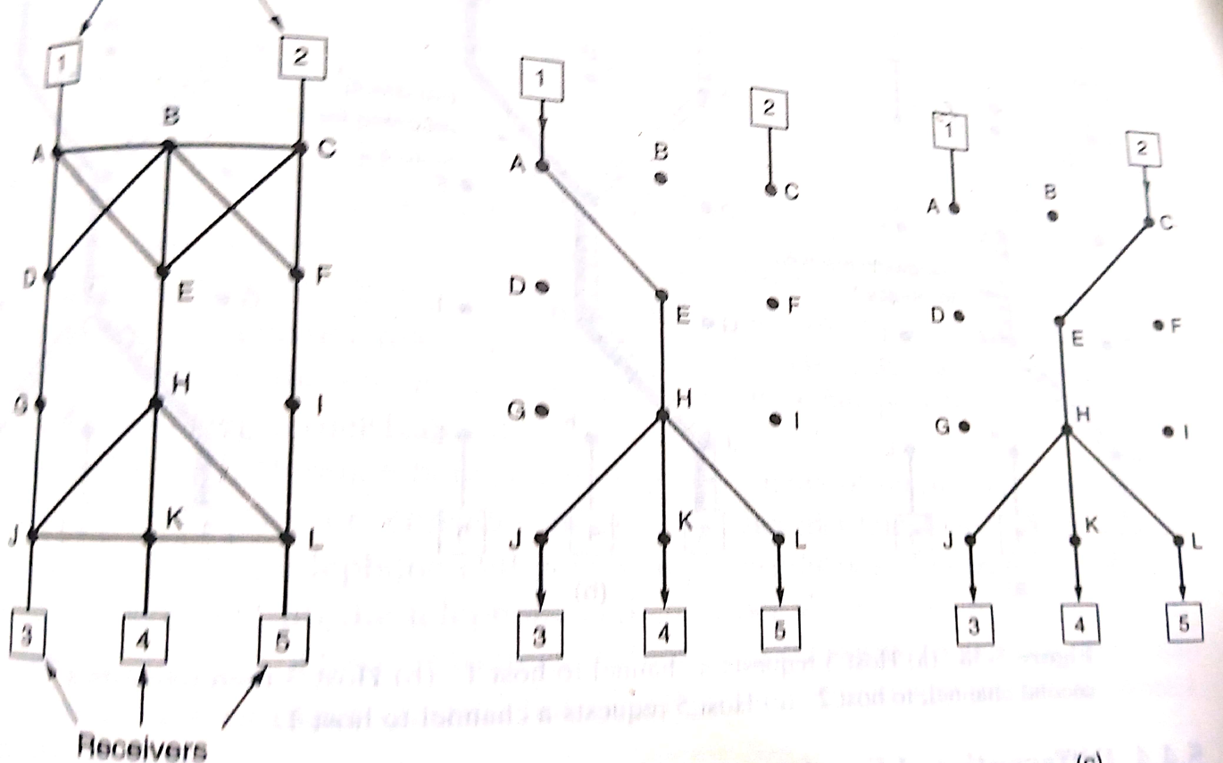
Resource Reservation Protocol
500

Slide 15
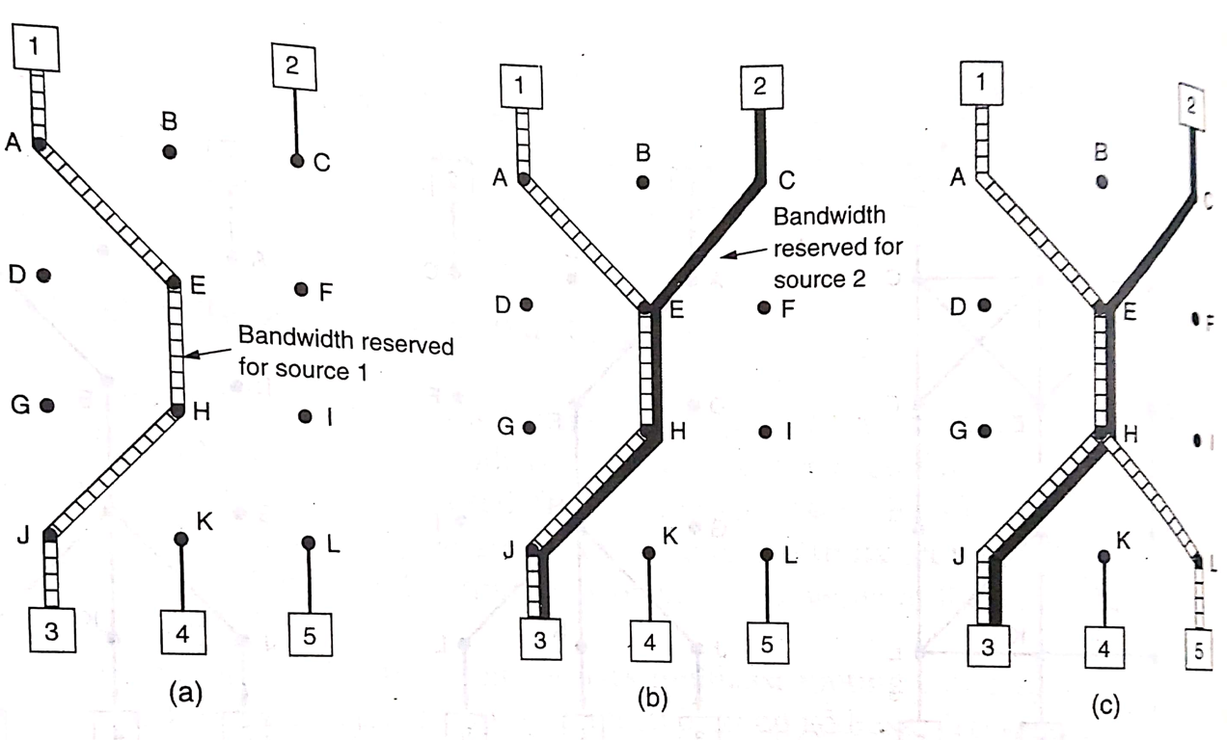
Resource Reservation Protocol
500

Slide 16
Resource Reservation Protocol
Types of RSVP Services:
Fixed-Filter RSVP (FF-RSVP): Establishes a single reservation for each flow, suitable for applications with strict QoS requirements.
Shared-Explicit RSVP (SE-RSVP): Allows multiple flows to share a common reservation, useful for multicast or multicast-based applications.
Benefits of RSVP:
End-to-End QoS: Provides mechanisms for applications to request and receive specific QoS guarantees from the network, ensuring predictable performance for critical applications.
Traffic Engineering: Helps in optimizing network resource utilization and managing traffic flows through explicit path setup.
Support for Real-Time Applications: Well-suited for real-time multimedia applications like voice and video conferencing, which require low latency and minimal packet loss.
500

Slide 17
Resource Reservation Protocol
Types of RSVP Services:
Fixed-Filter RSVP (FF-RSVP): Establishes a single reservation for each flow, suitable for applications with strict QoS requirements.
Shared-Explicit RSVP (SE-RSVP): Allows multiple flows to share a common reservation, useful for multicast or multicast-based applications.
Benefits of RSVP:
End-to-End QoS: Provides mechanisms for applications to request and receive specific QoS guarantees from the network, ensuring predictable performance for critical applications.
Traffic Engineering: Helps in optimizing network resource utilization and managing traffic flows through explicit path setup.
Support for Real-Time Applications: Well-suited for real-time multimedia applications like voice and video conferencing, which require low latency and minimal packet loss.
500

Slide 18
Resource Reservation Protocol
Limitations and Challenges:
Scalability: Managing per-flow state and maintaining RSVP sessions can be resource-intensive in large-scale networks.
Complexity: RSVP requires support and coordination across all network devices (routers and switches), which can add complexity to network management and operations.
Overhead: RSVP signaling messages and state maintenance can introduce additional overhead on network resources and bandwidth.
Deployment Considerations:
Enterprise Networks: Deployed in controlled environments where QoS guarantees are critical, such as in corporate networks or data centers.
Multicast Applications: Used in multicast scenarios to establish QoS guarantees for multiple receivers sharing the same data stream.
500

